Slide 1

Evaluating Database Systems and Analyzing Semi-structured cosmetic products Dataset
Bolormaa Mendbayar- x23176725
National College of Ireland
MSc in Data Analytics
Database and Analytics Programming

Slide 2

Outline
INTRODUCTION
Methodology
Results and evaluation
Conclusion and future work

Slide 3

INTRODUCTION
Why I chose this topic
The makeup and skincare world is always changing, offering tons of options for people everywhere. This study looks at a bunch of makeup and skincare products to see what's popular, how much things cost, and which brands people like. By doing this, we can figure out important things that help companies make better decisions about what to sell and how to sell it.

Slide 4
methodology
Dataset from Kaggle
Find the dataset on the internet
Connect and insert dataset to the MongoDB
Preprocessing dataset
Visualizations
Connect to Postgresql and convert to CSV
Modelling

Slide 5

Results from the project
Let’s Dive In

Slide 6
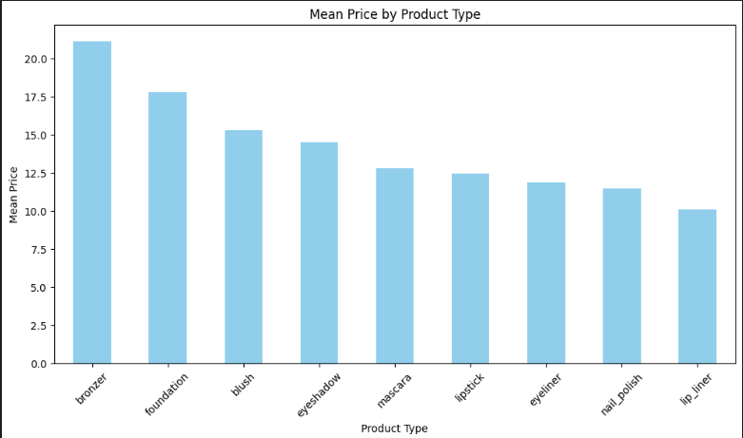
Mean price by product type

Slide 7
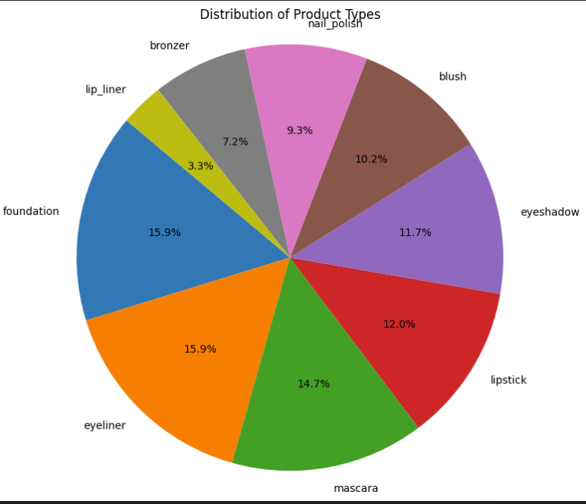
Distribution of product types

Slide 8
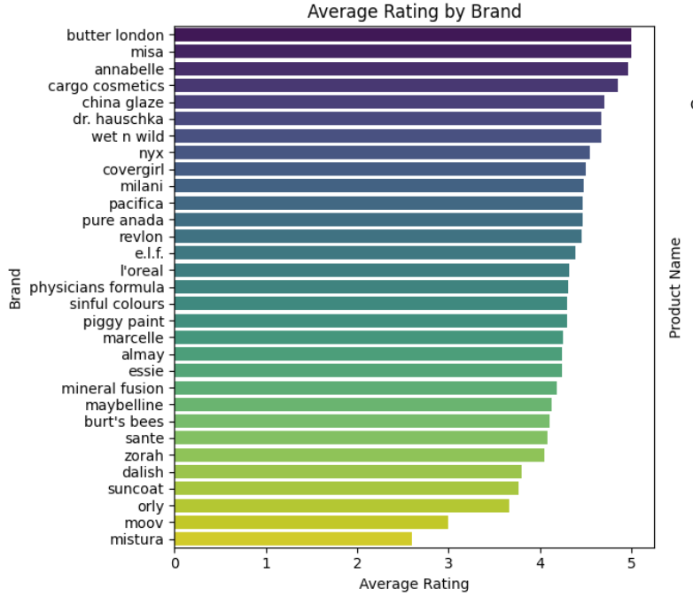
Average rating by brand

Slide 9
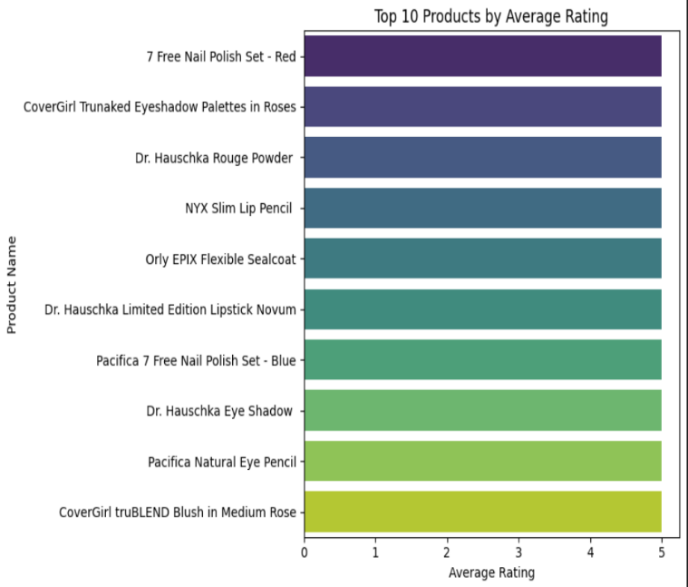
Top 10 products by average rating

Slide 10
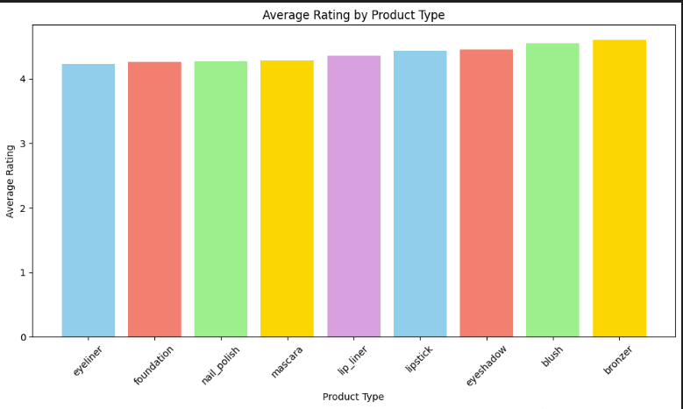
Average rating by product type

Slide 11
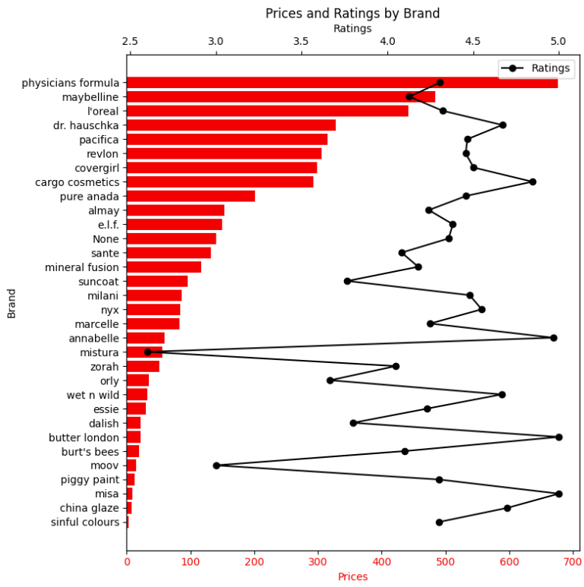
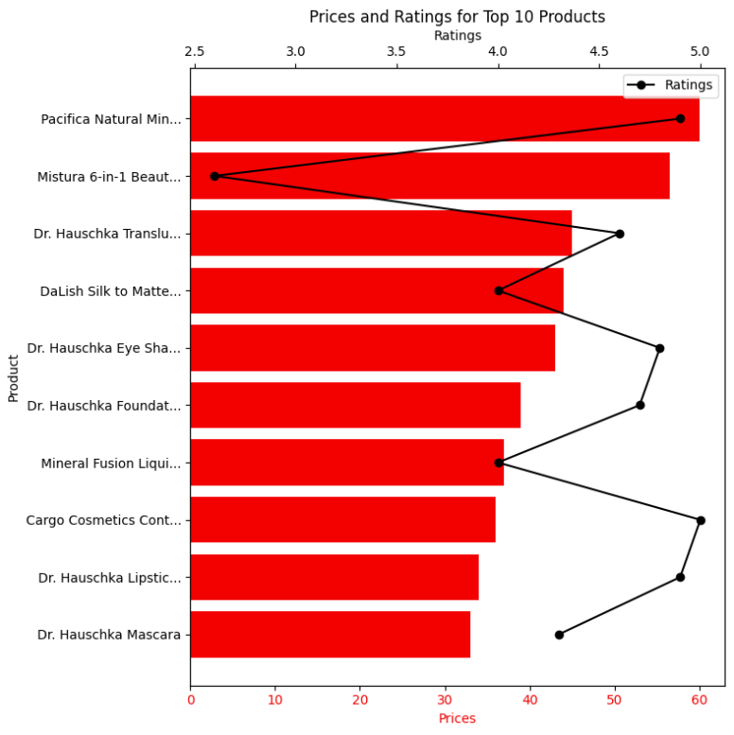
Price and rating by brand and products

Slide 12
To classify product types
Modelling Random Forest classification
Decision tree classification

Slide 13
Accuracy
Classification models | Accuracy
Random forest | 0.85
Decision tree | 0.94

Slide 14
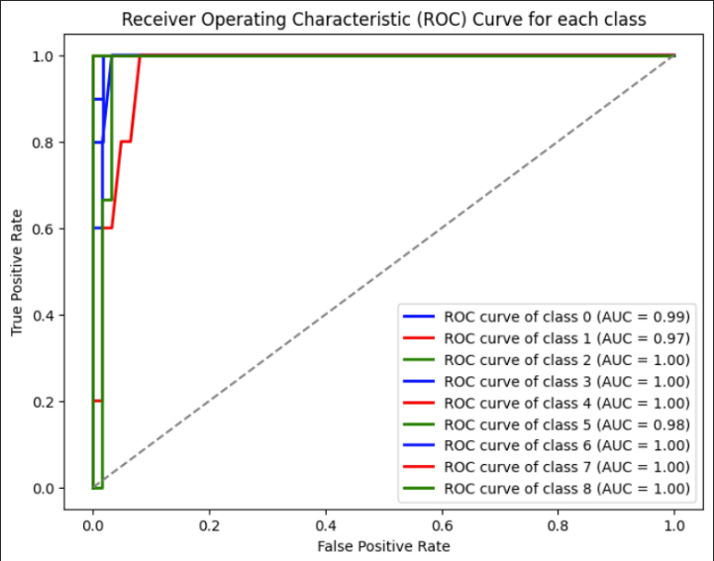
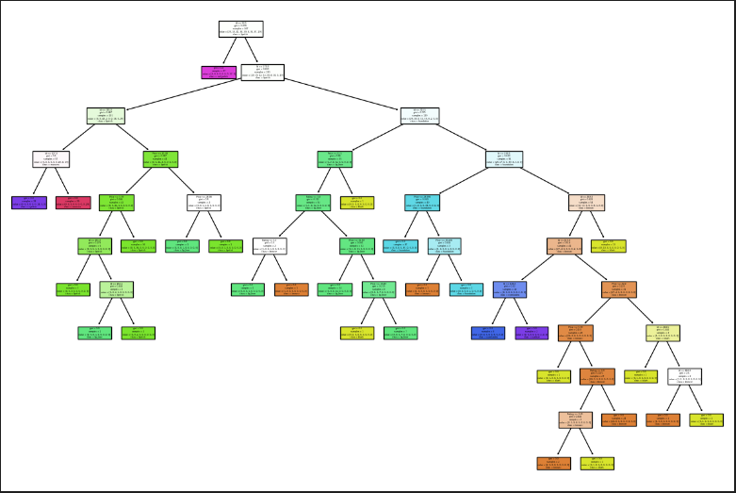
Decision tree random forest

Slide 15
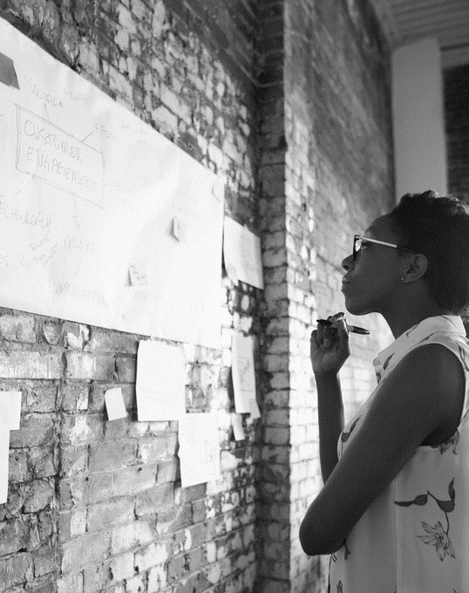
Conclusion and future work
Mooy and Mistura brands got 3 rating level which is the least
Create samples based on skin tone or skin type, and creating AI applications for 3D makeup, promotion and offer loyalty and discount
Products have 5 rating which is most satisfying products
Demand is likely to increase, prepare stocking well
Pricing appears to impact the ratings, indicating inverse correlation between two
Concentrating on a balanced approach may be helpful
Future work
Visualizing cosmetic sales data could be more effective for stakeholders, providing a clearer understanding of trends and patterns.

Slide 16

THANK YOU
Bolormaa Mendbayar
X23176725

